Slide 1
Test Automation
Principles, Terminologies & Implementations
Xin Li
December 16, 2009

Slide 2
Outline
Test Automation Principles & Terminologies
  Why Test Automation
  How to do Test Automation
  Terminologies about Test Automation (Sycamore)
Implement the Terminologies in Automation Scripts
  General Conventions
ClearCase Basic Operations

Slide 3
Why Test Automation

Slide 4
Top 10 Reasons for Automating Tests - What people said
Manual testing sucks.
Tool vendor said “Capture replay works.”
Fun to watch the dialogs popping on the screen.
“Afterwards we can fire all those pesky testers.”
Everybody else is doing it.
“No humans were harmed in the testing of this software.”
Big bucks already spent on the test tool.
Looks good on the resume.
No Testing for Dummies book ... yet.
Keep the intern busy.

Slide 5
Reasons for Automating – What people want
√
Speed up testing
Allow more frequent testing
Reduce manual labor costs
Improve test coverage
Ensure consistency
Simplify testing
Define the testing process
Make testing more interesting and challenging
Develop programming skills
Justify cost of the tools
Of course we’ll have automation!
x

Slide 6
How to do Test Automation

Slide 7
Keep it Simple, Sustainable
Uniform/Common infrastructure
Appropriate tools
Manage source code, test data, tools
Agreed Conventions within the team
High-quality Scripts
Gradual Test Automation

Slide 8
Quality of Automation Scripts
Maintainability
  Will the tests still run after product design changes?
  Will tests for 1.0 work with 2.0? And can be easily updated?
Reviewability
  Can others review and understand what is being covered?
  Are the scripts documented?, can we make sure it matches the original design?
  How about the coverage? How easy another engineer use the scripts for the next release?
Reusability
  To what degree the assets can be reused to create more, different tests?
  Can they be reused in different releases, in different environments?
Dependability
  Integrity
  Reliability
Repeatability
Independence
Performance
Simplicity

Slide 9
Terminologies for
Test Automation

Slide 10
Architecture for Automation
Test Planning
Test Preparation
Test Performing
Test Perfecting
Specify TestBed & TestCase List
For a release
Set a task to run a plan
Execute a task
Test Suite
Test Plan
Test Task
Test Report
Revised
Test Suites
Test Plans
Logical TestBed
+
Detailed Runtime Information
Detailed TestBed Information
Physical TestBed
Schedule
Runtime Options
Test Case
Test Case Result
Logical TestBed
Test Case
Test Case
Test Case
Test Case
Test Case Result
Test Case
…
…
…
…
Test Case
Test Case
Test Case Result
Test Case
Test Case
Test Case
+
Schedule
Runtime Options
…
…
Physical TestBed
…
Test Case
Test Suite
…
Detailed Runtime Information
Detailed TestBed Information
Test Case
Logical TestBed
…
Test Case
Test Case Result
Test Case
Test Case
Test Case Result
…
…
Test Case Result
Test Case
Test Step 1
Test Step 2
…
Test Step n

Slide 11
Test Bed
Briefly, a test bed is the definition of the environment for a specified test. A test bed include the hardware/software and configuration/provisioning.
There are two kinds of test beds:
  Logical TestBed. A logical test bed depicts all the elements and configuration required for the test, but not indicate which exactly elements will be used (i.e. the index or addresses are not required.)
  Physical TestBed. A physical test bed is an instantiation of a logical test bed. A physical test bed exactly indicates which elements are used in the test, and a test task can be really run on the test bed.
Base State of a test bed
  The initial state of the test bed, ready for test case (group) start to run with it.
  A self-cleaning test case (group) should get the test bed back to the base state when the execution completed.

Slide 12
Test Case (group)
A test case is a sequence of operations against a system whose results can be used to determine if a requirement or use case upon an application of the system is partially or fully satisfied.
  A test case contains a set of test steps, and based on a particular test bed.
  A test step is an atomic statement of a test case, can have pass/fail result. Usually it contains one operation and the expected result.
  A set of test cases can be grouped in a test case file.
Test Case File (test group):
  A test case file defines one or multiple test cases, which is based on a clean test bed for running, and do self-cleaning after performing all the cases one by one.
  A test group are a set of test cases saved in one test case file.

Slide 13
Test Suite
A suite of test cases, which share the same test bed to verify a specified feature in a specified test area. Usually, there are multiple test cases in one test suite.
In automation scripts, a test suite includes:
  A test suite file: to describe the basic information of this test suite
  A logical test bed: to define the test bed which the test suite is based on
  One or more test case files: each test case file is self-cleaning, so that each file can run independently.
Usually, test suite is feature oriented. It can be created once the feature is introduced, and keep being improved along the product life, or even product family life.

Slide 14
Test Plan
A test plan is an instantiation of a subset of a test suite, in which a set of test cases selected for a particular test for a feature in a program; and indicate the physical test bed for test performing.
  E.g. we have a BLSR_4F_2Node test suite, then we can make a plan for SN16K R9.0 BLSR 4F 2Node Regression test, targeted run it in two days.
In automation scripts, a test plan includes:
  Test suite path/name
  The physical test bed, which is an instantiation of the logical test bed
  A test case file list, selected from the test suite
Usually, a test plan is feature and release oriented. For different releases, one can have different test plan for one feature. And, a test plan should be defined in the test preparation stage.

Slide 15
Test Task
Test Task is a runtime concept, it defines when and how to execute a test plan. Once a test task is executed, a test report should be reproduced
In automation scripts, a test task could be a command in CLI, an item in TMS, or a file, which includes:
  The test plan path/name
  A schedule for the test plan running
  Runtime options, e.g. Halt or skip if any failure? Wait or fail if the test bed is not available? Recycle or one-time running?
Multiple test tasks can be created for a test plan, that means, a test plan can be executed multiple times in a release.
Usually, a test task is created in test performing stage by the tester for one-time running, and will not be reused.

Slide 16
Test Report
A test report is a result record of a test task.
Test reports can also be organized by test plans or test suites for broadened view to analyze requirements satisfaction.
A test report should have the following information
  Runtime information: e.g. who/where/how had run this task with what options?
  Detailed test bed information: e.g. build no. for each node, serial numbers of elements, software versions
  Test results for each case and each step.
A test report can be valuable just with a specified test bed on which the test was running.

Slide 17
Outline
Test Automation Principles & Terminologies
  Why Test Automation
  How to do Test Automation
  Terminologies about Test Automation (Sycamore)
Implement the Terminologies in Automation Scripts
  General Conventions
ClearCase Basic Operations

Slide 18
Classic Reasons for Automation Failure
10. No clear objectives for automation.
9. Minimal or No attention of non GUI automation.
8. Lack of methodology to success of the project.
7. Automation is easy Just record and playback. –
6. Aim for 100% automation.
5. Testing for automation scripts.
4. No clarity of real cost involved in automation.
3. Automation is part time job of testers.
2. Wrong selection of Test cases.
1. Not treating automation as software development.

Slide 19
General Conventions

Slide 20
Branch Policy – Scripts management
Each release will have a branch.
Branch info and configure spec will be sent out after the branch is created.
After the branch is created, everyone should make sure that all file changes are saved in this branch.
Configure spec can be found in the tools folder

Slide 21
Common File Structure in ClearCase
First level: Product Name
  Switch xxxx, or
Second level: Test area
  Feature name
    E.g. for Switch: STP, L3 switch,
    Smoke test
Third level: Test Suite
  Create when upload scripts
  The name should be easy to understand

Slide 22
Test Suite Define
TestSuite.pl (file, the name should not be changed)
A simple Perl script to describe the basic information of this test suite. It can be a service provisioning script.
LogicTestBed (file, could have different extension name. e.g. LogicTestBed.txt; LogicTestBed.pl)
A simple Perl script or text file to describe all the elements and configuration required for the test suite.
TestCases (Directory, the name should not be changed, all test cases scripts should be included in this directory)
  Case1Name.pl (cases Perl scripts, file names can be defined by the scripts writer as he/she wants)
  Case2Name.pl
  …
  CasenName.pl

Slide 23
Test Suite Define (Cont.)
TesPlans (Directory, the name should not be changed, test plans are included in this directory)
  TestPlan1.xml (XML file, the file names can be defined by test engineers, used to select test cases that will be run)
  TestPlan2.pl (Perl file is OK)
  …
PhysicalTestBeds (Directory, all physical test beds should be included in this directory)
  PhysicalTBName1 (Physical test beds, file names can be defined by test engineers. Used to indicate which equipments are used in the test. For TEA script, it is the configure file. )
  …
  PhysicalTBNameN
… (Other optional files or directories, could be common codes, or packages just for this test suite.)

Slide 24

Pet Status-Automation Use Pet/Library
Automation Should Base on Library and Framework.
You should not setup automation base on ground But on the shoulders of giant.
Robust and maintainability is more than other in automation scripts.
Silk Library
web Library
Run Engine
Error Recovery
…..
TEA Library
Node/ RT9000
Etc…
Common Lib
Report logger
…..

Slide 25
Outline
Test Automation Principles & Terminologies
  Why Test Automation
  How to do Test Automation
  Terminologies about Test Automation (Sycamore)
Implement the Terminologies in Automation Scripts
  General Conventions
  9K Implementations
  SilvxManager Implementations
ClearCase Basic Operations

Slide 26
Clear Case
Base Concept
Create View
Update Conf Spec

Slide 27
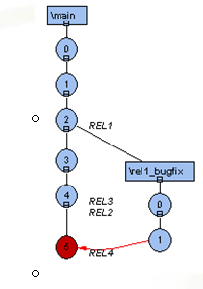
Clear Case-Base Concept
ClearCase
  ClearCase is a software configuration management (SCM)
Vobs
  database that stores your project's files
ClearCase Elements
  The objects in a VOBs
Views
  filter that allows you to see at most one version of each element in a VOB
  Snapshot
  Dynamic
Conf Spec
Branch
  parallel development

Slide 28
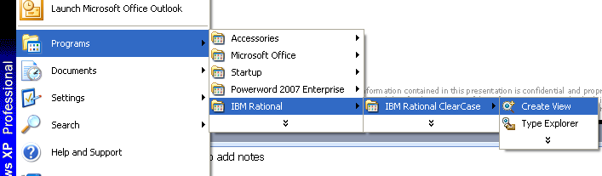
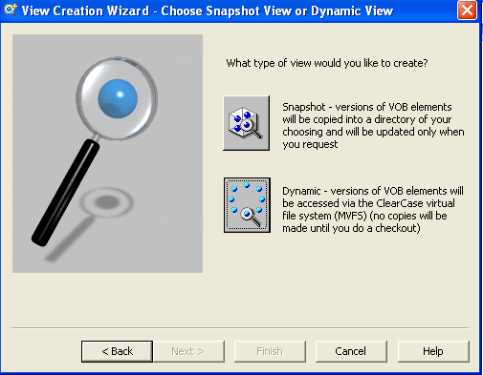
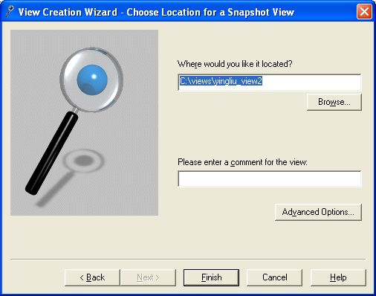
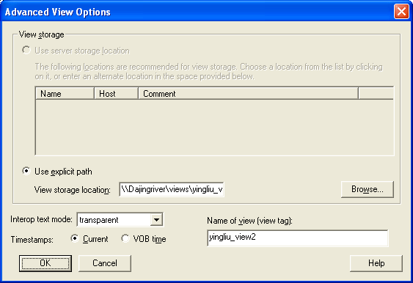
Clear Case Base Operate-Create View

Slide 29
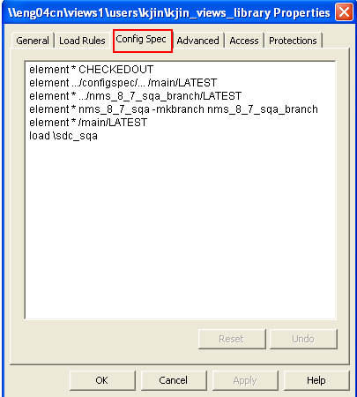
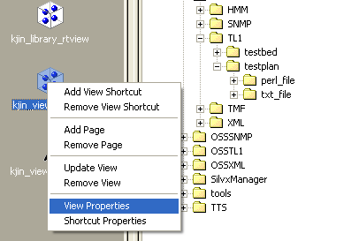
Clear Case Base Operate-Update Conf Spec

Slide 30
References
Recommended Automation Scripts Files Architecture
Automation Programing Guide
QA Scripts Code Conventions
Perl Engine for Test Automation Specification
Tea Engine Automation Spec
Test Management System MRD
Test Management System Software Architecture and FS

